Slide 1
Indus Valley Civilization
Dr. Md. Faruk Shah
Adjunct Faculty Member
Department of History and Philosophy
North South University

Slide 2

Lecture Outline of Indus Valley Civilization
Background
A planned urban city
Government and religion
Social and economic life
Women status
Caste system

Slide 3

Background
The first Indian civilization, known as Indus Valley Civilization emerged in 2500 B.C.
Originated in the Indus River Valley, currently belongs to Pakistan and north west India
Developed at two locations on the Indus River: Mohenjo-Daro and Harappa
Each city was larger than any Sumerian city-state.
This civilization is contemporary to Egypt and Mesopotamia civilization.
In 1921, archaeologists discovered traces of this civilization.
Yet scholars know little about the civilization compared to other civilizations.
https://www.youtube.com/watch?v=juc3msgLMoc
https://www.youtube.com/watch?v=KhDY4KJuvc0

Slide 4
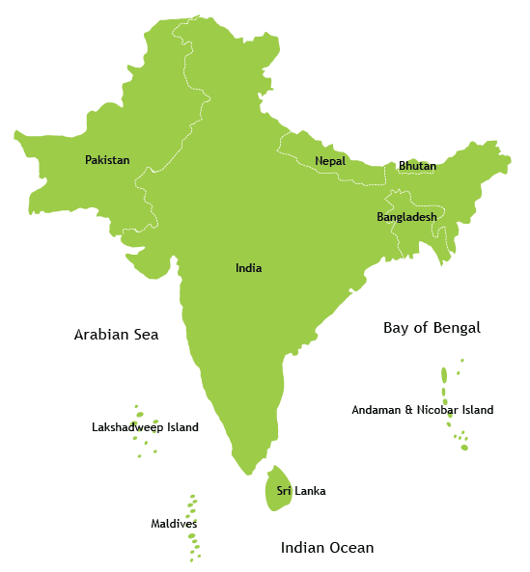
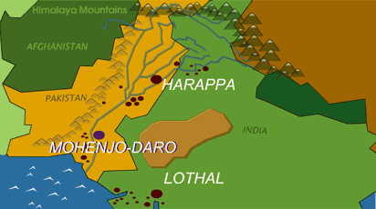

Slide 5
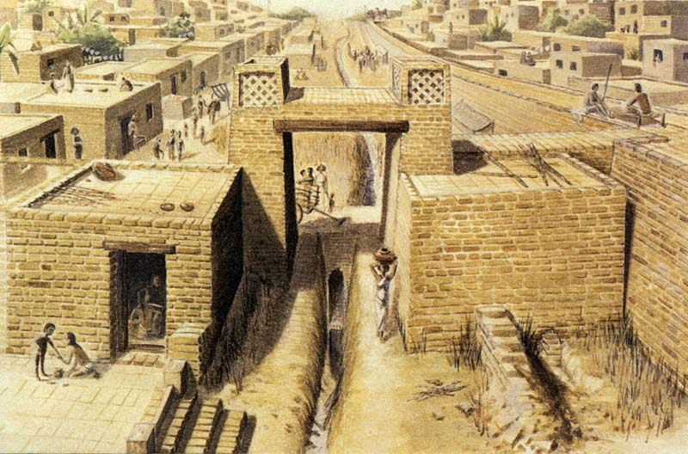
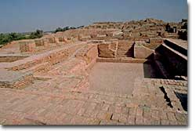
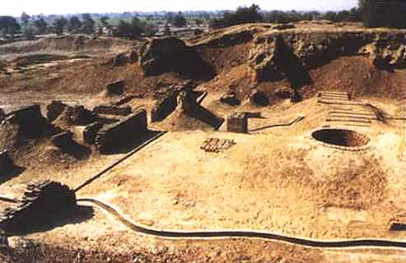
A Planned Urban Society
Harappa & Mohenjo-daro: both cities were surrounded
by smaller cities, towns, and villages
One situated in the north and other in the south
Pattern of building was very-large
Had palaces and temples
Patterns of houses were two to three storied
Roads were wide and long
Largest structure found is called the Great Bath (swimming pool)
Public wells supplied water & bathrooms used an advanced
drainage system.
A drop system took household trash to public garbage bins.

Slide 6
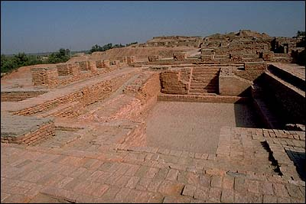
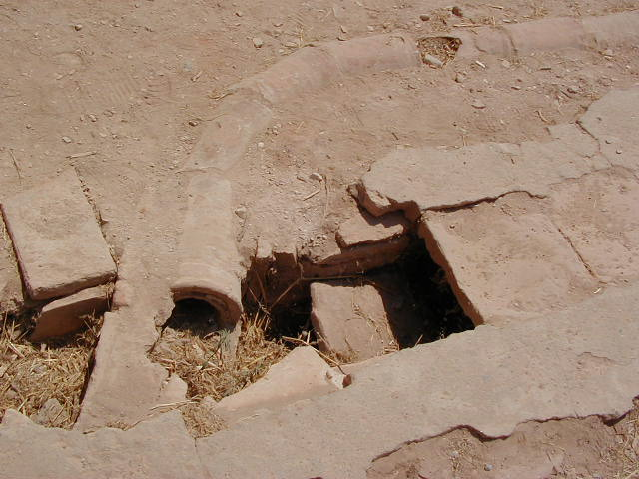
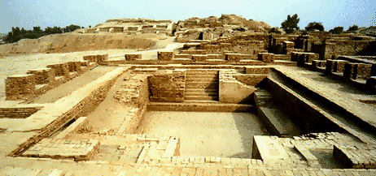
Urban Facilities
Archaeologists have discovered houses, granaries, public halls,
& shops.
Cities were incredibly well planned.
Supporting capacity was as many as 80,000 people
Both cities had extensive drain systems.
Walled fortresses with towers provided protection.
To create such well-planned cities, the people needed a
knowledge of surveying and geometry.
Possessed practical details of planning and construction.
Each city was laid out in a grid pattern, the blocks similar to
those seen in modern cities.
Streets were lined with storehouses, workshops, market stalls,
and houses.

Slide 7
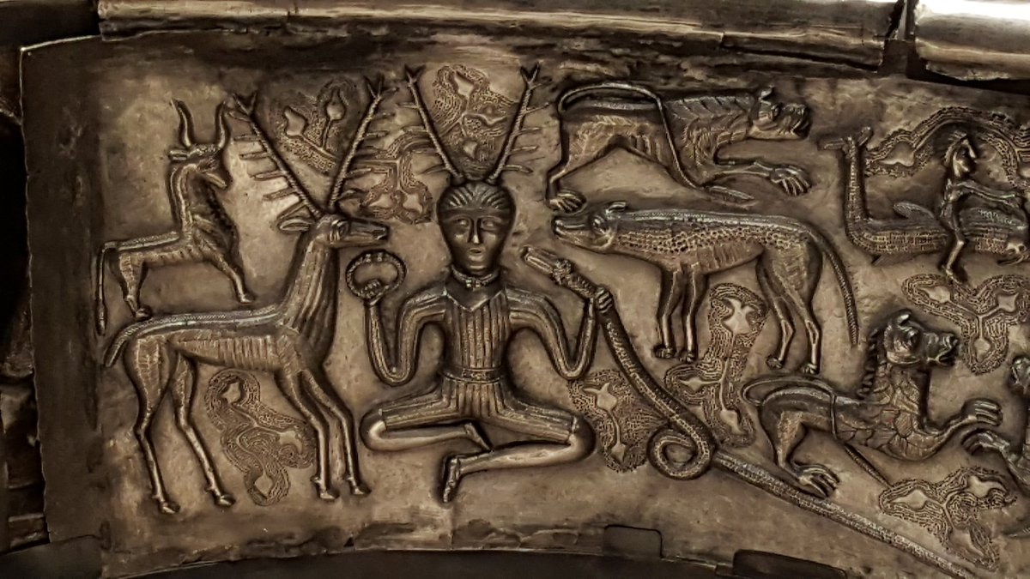
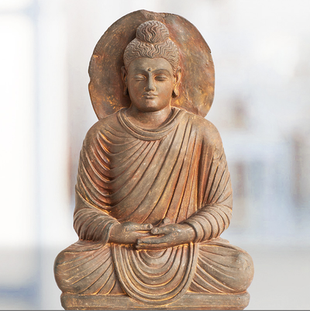
Government and Religion
A priest-king probably headed the government
of each city.
Rulers had considerable power
Priest-kings made sure all had steady
supply of food
Building construction pattern indicates a
strong government planners
The Indus Valley people were polytheistic.
Worshipped a mother-goddess and a three-faced
god.

Slide 8
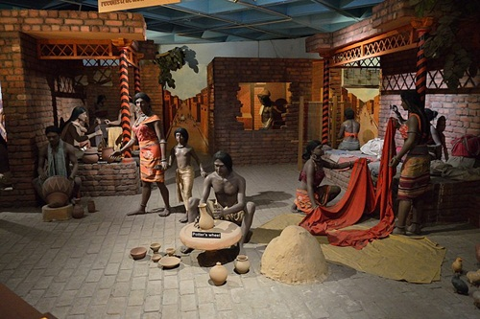
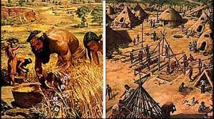
Economic Life
Most of the people were farmers
Had a thriving agricultural economy.
Farmers constructed dams to channel water from the
rivers to crops wheat, barley, melons, and dates.
Food surpluses supported the large city populations and
prompted the growth of trade.
Wealthy citizens hired artisans to make furniture inlaid
with the precious metals.

Slide 9
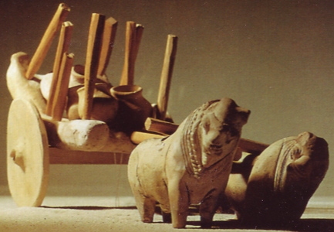
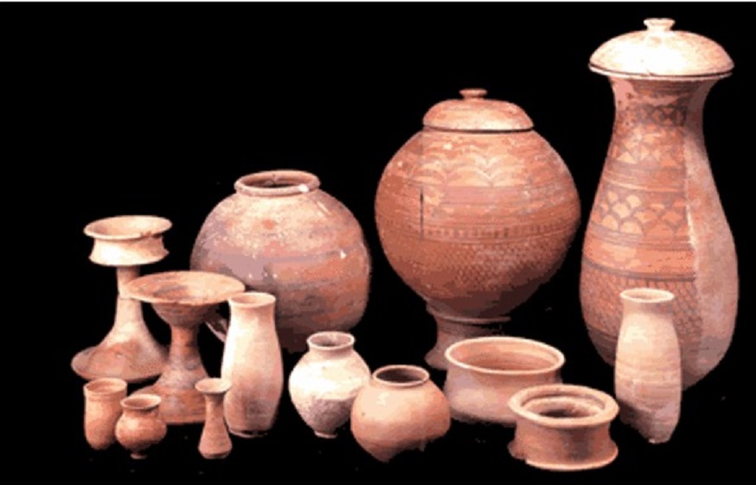
Trade
People grow cotton.
Trade and commerce supported a prosperous merchant class
in the cities.
Merchants exported cotton cloth in exchange for precious
metals.
Contact caused system of writing to be born.
Traded cotton, grain, copper, pearls, and ivory
Weight and measurement (scale) systems were created by
Indus valley people.

Slide 10
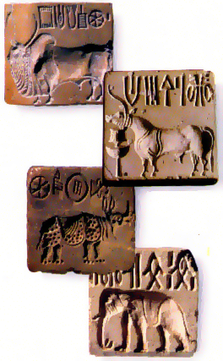
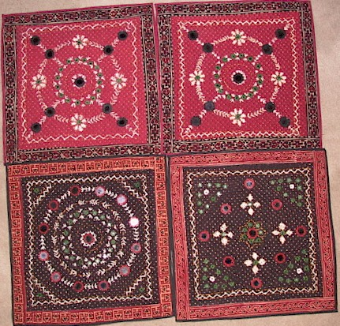
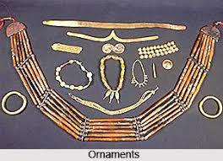
Cultural Life
Occupational diversity
Artistic Achievements: skilled artisans (pottery vessels,
jewelry and ivory objects)
Dance culture

Slide 11
Practice of Science
Road and building
Medicine
Agriculture

Slide 12
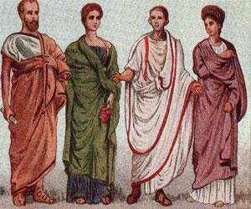
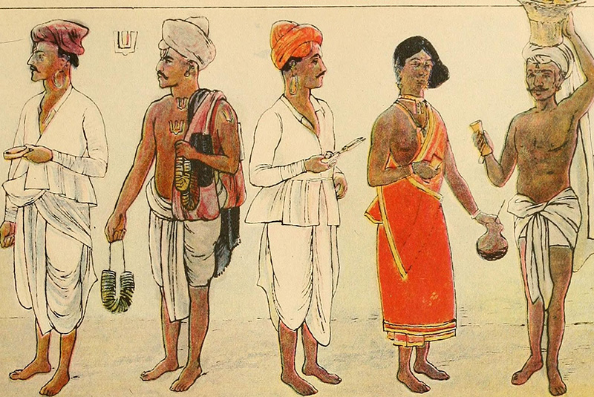
Daily Life
Shortages of essentials were mostly unknown or only in small areas.
Life standard was not high as today; but people seemed
to lead a happy life.
In case of shortage of food supply, they used to migrate.

Slide 13
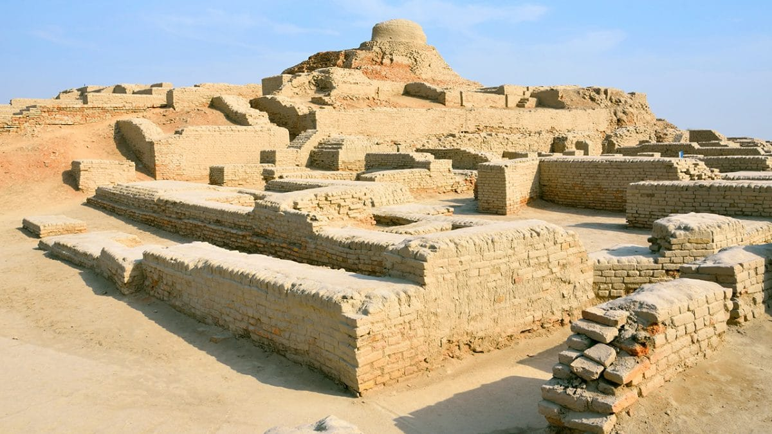
Decline of the Civilization &The Aryan Invasions
Not much known about the decline of this civilization around 1750 B.C.
Then about 1500 B.C., nomadic warriors known as the Aryans conquered the Indus Valley.
Theories of decline:
1. Ecological changes/disasters
Drought
Earthquake
Flood
Over population
2. Aryan invasion – invading armies forced people to move?
Settlement by nomadic people: the Aryans

Slide 14
The Aryan Culture
Practice of joint family
Women were not allowed to attend public meetings and hence became subordinate to men.
A basic rule of the society was that a female’s fundamental dharma in all castes was to obey and serve her husband and her sons.
Gradually, the ritual of widows’ suicide (sati: SAH-tee) became established.

Slide 15
Caste SYSTEM
A type of social organization/hierarchy in which a person’s occupation and position in life is determined by the circumstances of his birth.

Slide 16
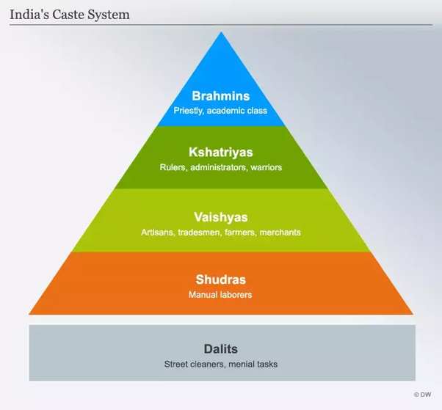
Caste System Hierarchy

Slide 17
Features of Caste System
Indian society developed into a complex system based caste
Caste is based on the idea that there are separate kinds of humans
Higher-caste people consider themselves purer than lower-caste people.
There are five different levels in the Indian Caste system.
Brahman, Kshatriya, Vaishya, Shrudra, and, Harijans.

Slide 18
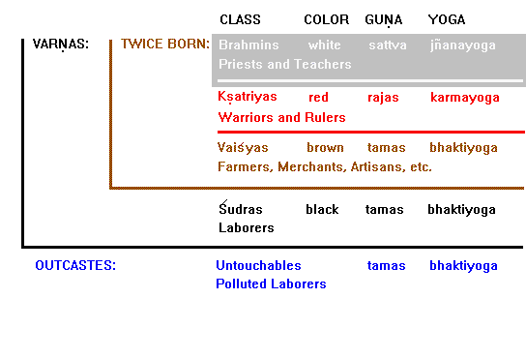
Corresponding Colors

Slide 19
How Caste Shapes Society
Rigid, hereditary membership into birth caste
Marriage only among member of same caste
Occupation choices restricted
Personal contact with other castes restricted
Acceptance of fixed place in society

Slide 20
Thank You and Questions???

